Slide 1
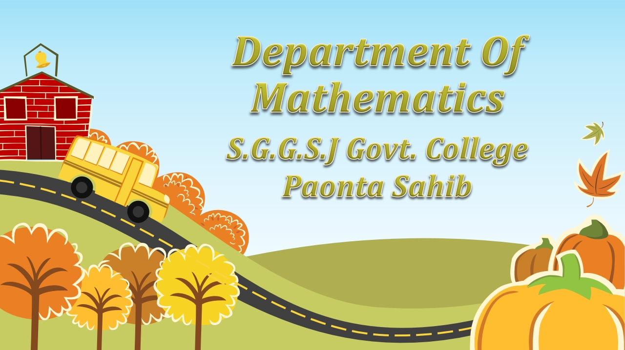

Slide 2


Slide 3







Slide 4

The process of finding the area bounded by a given portion of a curve is called quadrature .

Slide 5

Let f:[a,b] ⇾ R be a continuous function. Thcn the area bounded by the curve y = f(x), the axis of x and the ordinates at x =a and x =b is given by
b
∫y dx
a

Slide 6
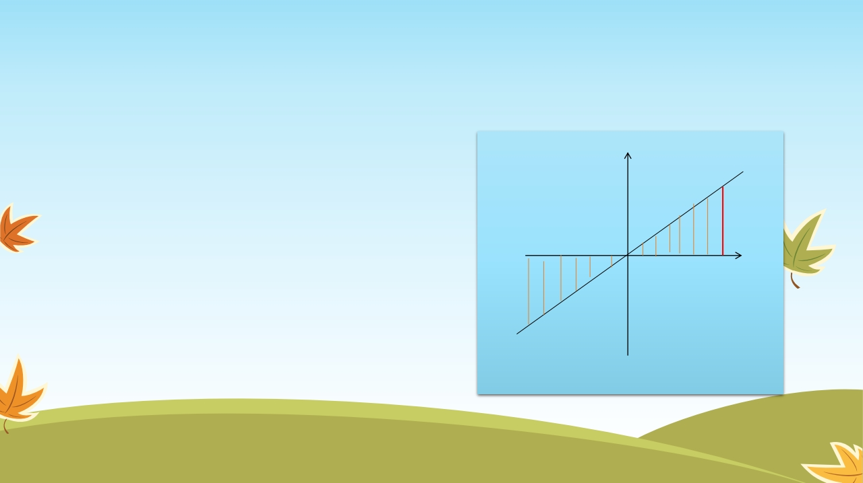
Question:- Find the area bounded by the line
y = x , x = -1 , x = 1
Solution :- The eqn. of the lines are y = x , x = -1 , x = 1
Y
B
Required area = 2 ( area OAB) 1 1
X = 1
= 2 ∫y dx = 2 ∫ x dx
o A X
X = -1
0 0
2
1
= 2 [ x /2] = 2 [ ½ - 0 ]
0
= 1 sq unit

Slide 7

If x(t) , y(t) , t∈[a,b] describes a parametric curve bounding a region of the Cartesian plane, the area of this region is
b
∫y(dx/dt) dt
a

Slide 8
Question :- Find the area of the curve
3 3
x = a cos t , y = b sin t
Solution:- The parametic equation of the curve are
x = a cos t , y = b sin t
3 3
2
༜ dx/dt = - 3a cos t sint
The curve is symmetrical about both axis and in the first quadrant t varies from 0 to π/2

Slide 9

π/2
∫y(dx /dt)dt
༜ area of the curve = 4 π/2
0
= 4∫ bsin t [ -3 a cos t sint ] dt
Y
3
2
t= π/2
0
π/2
= -12 ab ∫ sin t cos t dt
4 2
0
= -12ab (3.1.1/6.4.2) . π/2
t = 0
o
X
= -3/8π ab = 3/8 π ab (In magnitude)

Slide 10


